Slide 1
Graphics in Android
James Tillma and Teresa Worner

Slide 2
Overview
Layout
Canvas Drawing
Drawables
Bitmaps
Bling

Slide 3
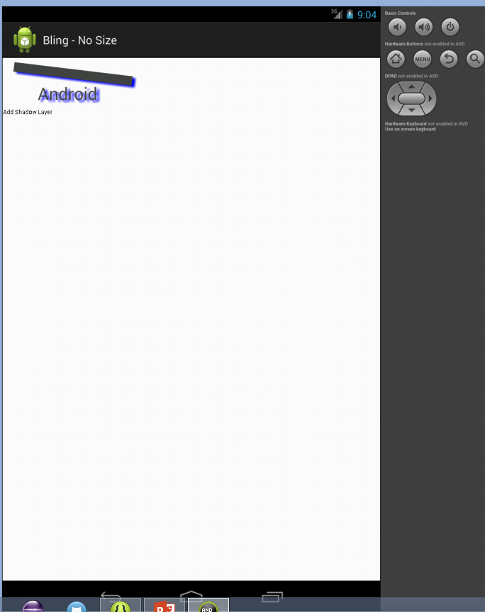
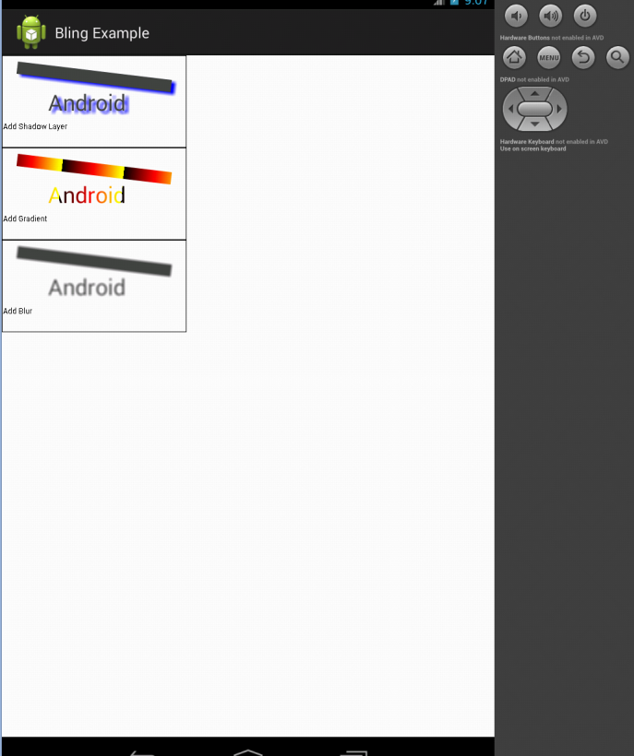
Layout
Measurement
setMeasuredDimensions()
onMeasure()
measureSpec
Arrangement
Mostly system controlled
Custom onLayout()

Slide 4
Canvas Drawing
onDraw() override
Anything you want drawn goes here
Use cached data, don’t do calculations here
Four Main classes
Canvas
Paint
Bitmap
Drawable

Slide 5
Canvas Drawing Cont’d Drawing Text
Text rendering needs canvas
Canvas has three text drawing methods
drawText(String text, float x, float y, Paint paint);
drawTextOnPath(String text, Path path, float hOffset, float vOffset, Paint paint);
drawPosText(String text, float[] pos, Paint paint);

Slide 6
Canvas Drawing Cont’d Matrix Transformations
Canvas has built-in transforms
rotate(float degrees);
scale(float x, float y);
skew(float x, float y);
translate(float x, float y);
Can use setMatrix() and/or ConcatMatrix() to build your own transformations
Axes
+x = Right
+y = Down
Origin = Upper left

Slide 7
Drawables
Object that knows how to render itself
Can be used to encapsulate code
Can be nested for complex rendering
If the user needs to interact with it, use a view instead

Slide 8
Bitmaps
Canvas already has bitmap
Used to cache a complicated drawing
Example: Paint program with layers
Cache each layer and toggle visibility instead of redrawing

Slide 9
Bling
Shadows, Gradients, Filters, and Hardware Acceleration
OpenGL Graphics
“The Android UI framework is a lot more than just an intelligent, well-put-together GUI toolkit. When it takes off its glasses and shakes out its hair, it can be downright sexy!” – Programming Android, pg 248

Slide 10
Shadows, Gradients, Filters, and Hardware Acceleration
PathEffect – methods that affect actual geometry of object
MaskFilter
ColorFilter
Shader – methods that affect color gradients
ShadowLayer – methods that affect shadow distance and light angle
Hardware Acceleration
Added to Honeycomb
Not default
Can be controlled at most any level
(developer.android.com)

Slide 11
OpenGL Graphics
Painful on your own
Android has interface
Useful for complicated graphics
“The Android platform supports OpenGL graphics in roughly the same way that a silk hat supports rabbits.” – Programming Android, pg 258

Slide 12
Questions?

